Slide 1

By:
Dhruvil, Sonali, Danielle, Fawaz, Siddhesh, Ekkasit and Kyle

Slide 2
Agenda
What is the Problem?
What is Virtual Advisor?
Who are the Customers?
The Benefits of Virtual Advisor
What are the Deliverables
How does the Virtual Advisor Make the world a better place?
Deadlines / Plan / Approach

Slide 3

What is the Problem?
Time conflicts between advisors and students.
Tedious course and concentration selection process.
Difficulties in finding the professors’ names and personal advisor.
Tracking the actual progress of the courses completed and required at both the graduate and undergraduate level is mess.
Application process to graduation is manual and time consuming.

Slide 4
What is Virtual Advisor?
A system that assists Stevens’ students in knowing what classes are required, what classes he/she has taken, and when those classes are offered for his/her chosen major and/or minor. Unlike a human advisor, this system will show every possible path with its requirements, alumni reviews, and jobs opportunities. In addition, it lets the students choose in what direction to move forward.

Slide 5

Customer Base:
University Students (graduate and undergraduate)
Potential Students to see what majors have what requirements and the path each can take
Students’ Advisors (to approve the path they have chosen)
Registrar faculty
University Professors

Slide 6
Benefits of Virtual Advisor
Everything is Digital
Available 24/7
Provides information about classes ( availability and class schedule ) according to departments and semester
Not Biased
Shows the remaining requirements due for graduation.

Slide 7
Benefits Cont..
Students can track their grades, courses to take ( according to their study plan ), concentration selection (How to choose courses to specialize in particular/desired area), course progress, and application to graduation.
Students can see the list of professors and his/her personal advisor.
Instant and accurate feedback to the user base.
Organization of multiple topics in regards to student registration.

Slide 8

Deliverables
Login system based on stevens ID.
Grade and course progress tracker
Classes availability and schedule ( according to semester)
List of professor and course advisors according to department and major
Course and concentration recommender

Slide 9
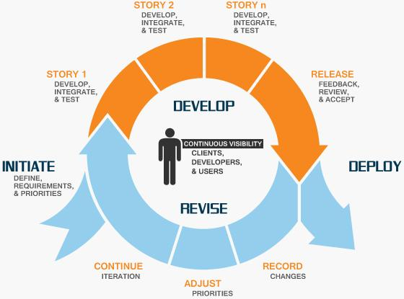
Plan / Approach - Agile

Slide 10
How does the Virtual Advisor
Make the world a better place?
Virtual Advisor is a one-stop-shop for a University’s Registration Process. It automates, guides, simplifies, and organizes the complex task of student registration. Virtual Advisor doesn’t replace one-to-one interaction with advisors but enhances this relationship for prompt graduation. Student advising plays a key role in student’s success.Our application hopes to optimize this success by offering convenience to members involved in this process.
Let’s make registering great again!

Slide 11



